Slide 1

BANK ANALYTICS

Slide 2

CONTENTS
KP-1: Year wise loan amount Stats
KP-2: Grade and sub grade wise revolving bal
KP-3: Total Payment for Verified Status Vs Total Payment for Non Verified Status
KP-4: State wise and month wise loan status
KP-5: Home ownership Vs last payment date stats

Slide 3
PROJECT OBJECTIVE :
This is Bank loan of Customers project where we were provided with 2 datasets with .csv extension files having 39k rows each and the objective was to analyze the growth that bank got within given years in loans.
We used MS-Excel, MySQL for analyzing, cleaning and removing duplicates from dataset and prepared dashboard using Tableau and PowerBI tools where we did calculations, merging and prepared interactive dashboards.

Slide 4
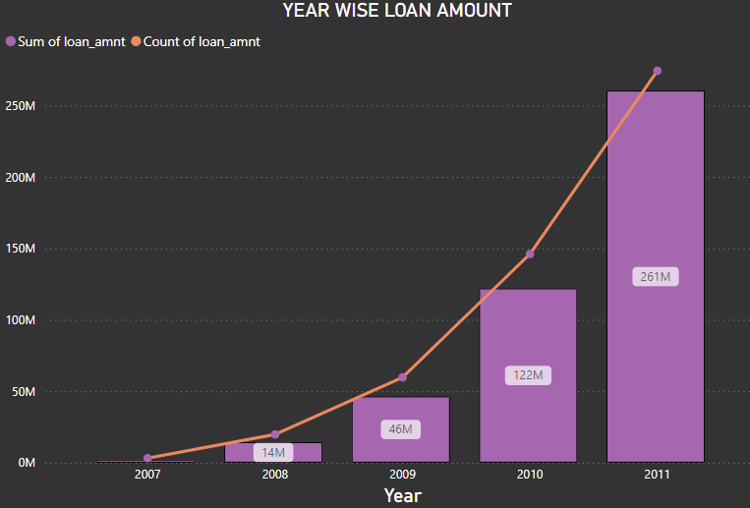
KPI-1
By examining the chart, we can observe the annual increase in the loan amount.
Starting in 2007, the loan amount was 22,19,275, and by 2011, it had grown to 26,05,06,575. By subtracting the initial value from the new value, we can determine the difference: 26,05,06,575 - 22,19,275 = 25,82,87,300
This indicates an increase of 25,82,87,300 over a span of 4 years.
The total loan amount across all years sums up to 44,56,02,650.00.
Year wise loan amount Stats :

Slide 5
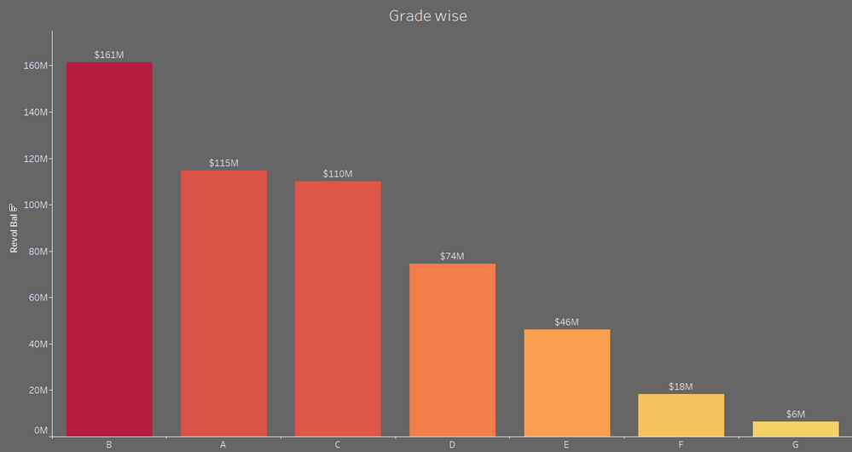
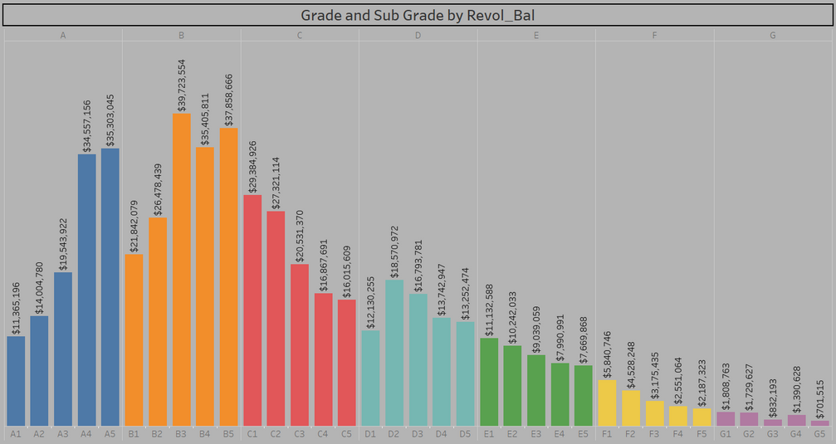
KPI-2
In this grade and subgrade-wise revolving balance analysis, we observe that Grade B has a higher revolving balance than any other grade, while Grade G has a very low revolving balance.
Grade B customers typically have a higher annual income with over 10 years of employment. Consequently, higher annual income results in a lower debt-to-income ratio, leading to more customers taking loans in Grade B.
This pattern is also seen in other grades, with the revolving balance following the order: B > A > C > D > E > F > G, corresponding to their annual incomes.
Grade and sub grade wise revol_bal :

Slide 6
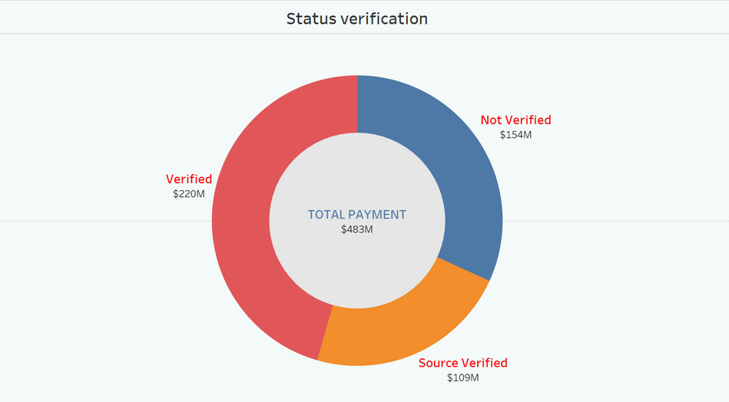
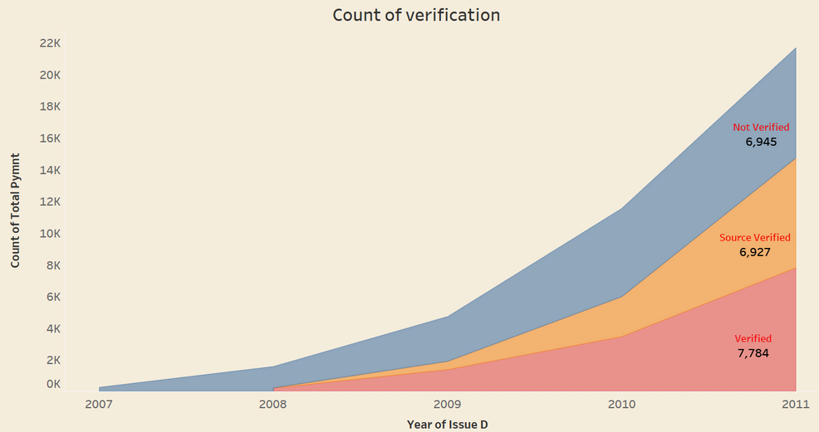
KPI-3
Total Payment for Verified Status Vs Non Verified Status :
This is the first stage of the verification process. The bank requires a loan application to begin collecting and verifying the necessary documents.
The pie chart reveals that 58.88% of the total payments have been verified, while 41.12% of the total payments have not been verified for the loan amount. This indicates that the majority of the loan payments have passed through the verification process, but a significant portion still requires verification.

Slide 7
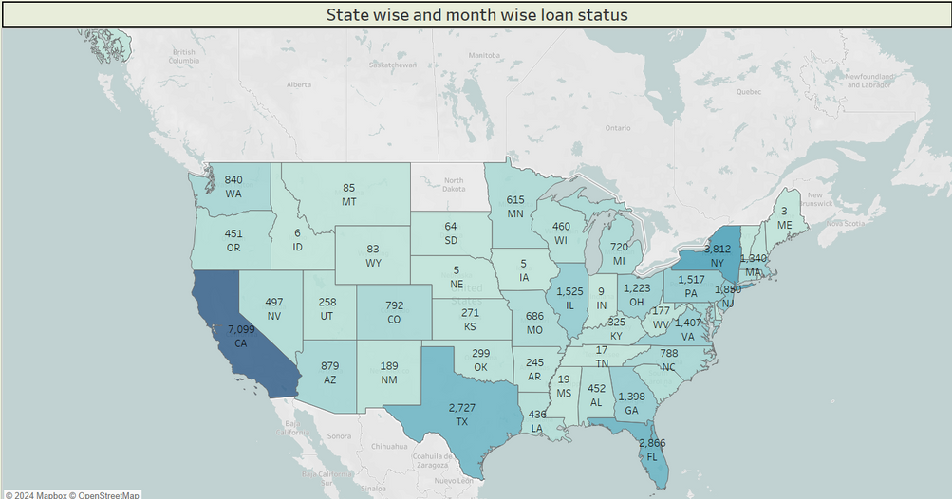
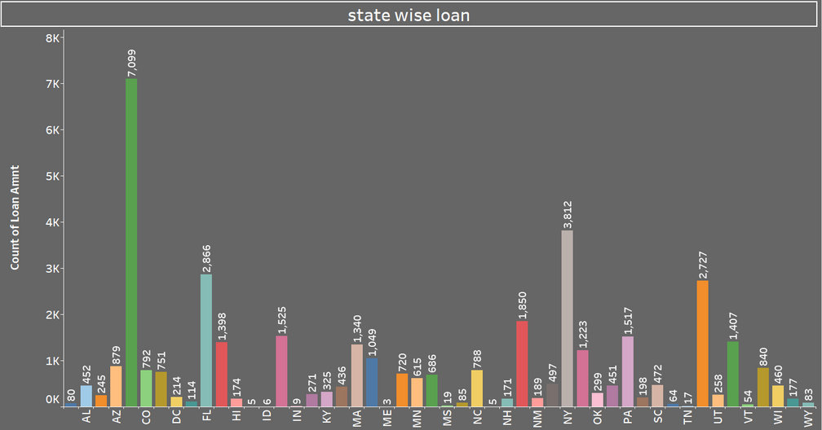
KPI-4
State wise and month wise loan status insights:
The right graph illustrates the number of loan statuses for each state in the USA as of a particular last credit pull date.
From the graph, it's clear that California (CA) has the largest number of customers who have taken out loans, with the count surpassing 5,000.
Additionally, the data reveals that 97% of the bank's customers across all states have a status of fully paid. This high percentage indicates a strong repayment performance among the bank's loan recipients in every state.

Slide 8
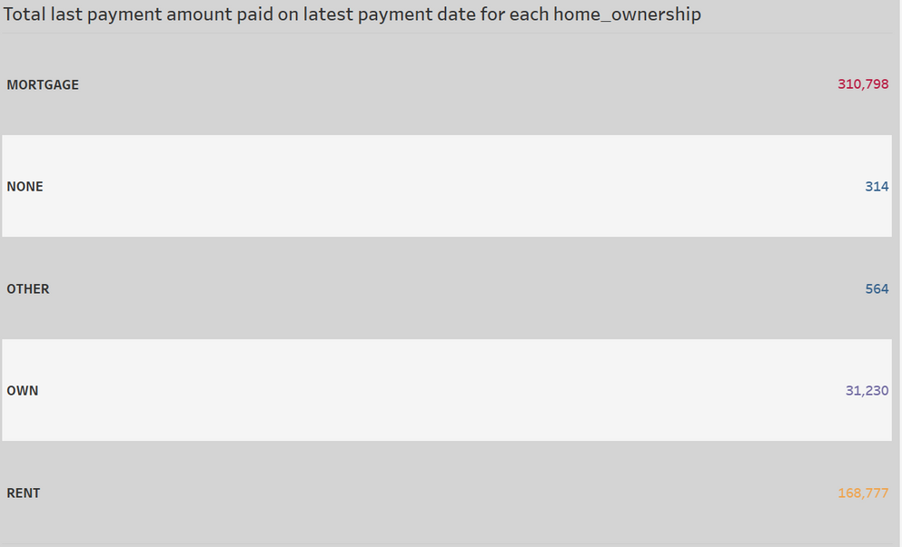
KPI-5
Home ownership versus last payment date stats insights:
The right graph depicts home ownership categories and the corresponding amounts paid as of the most recent payment date.
We observe that customers with MORTGAGE home ownership have made the highest latest payment, amounting to Rs. 310,798.
This indicates that a significant number of customers are nearing the completion of their loan repayments for their respective home ownership.

Slide 9
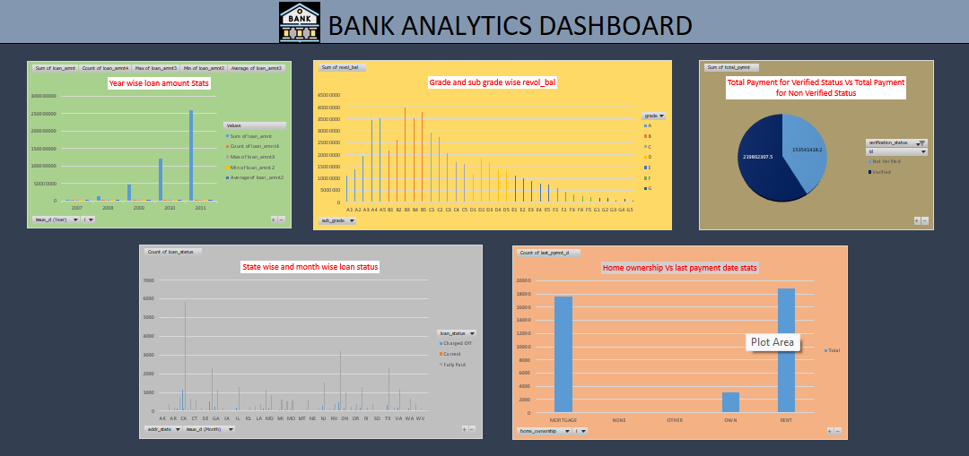
EXCEL - DASHBOARD

Slide 10
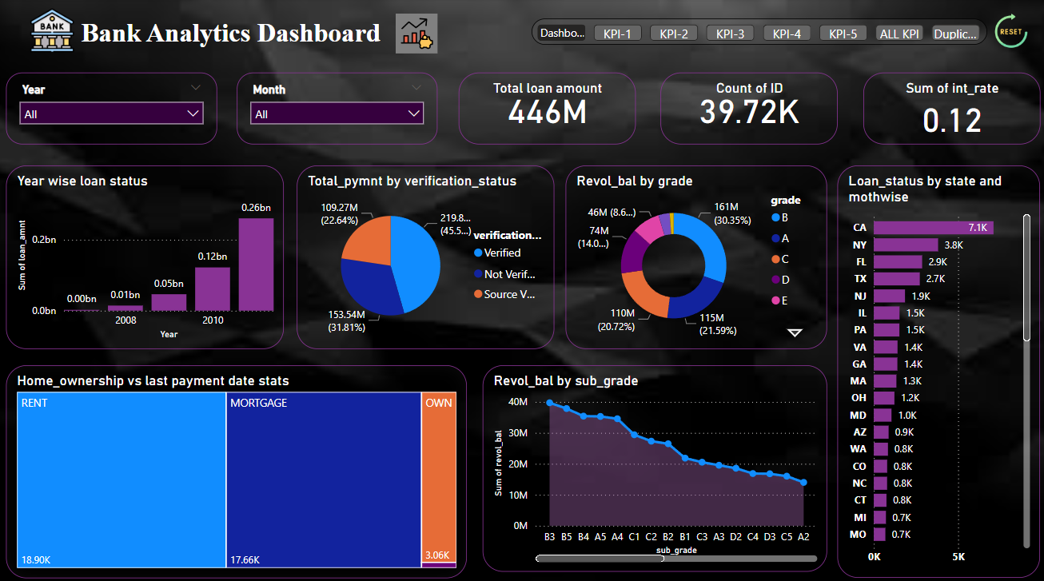
POWER BI - DASHBOARD

Slide 11
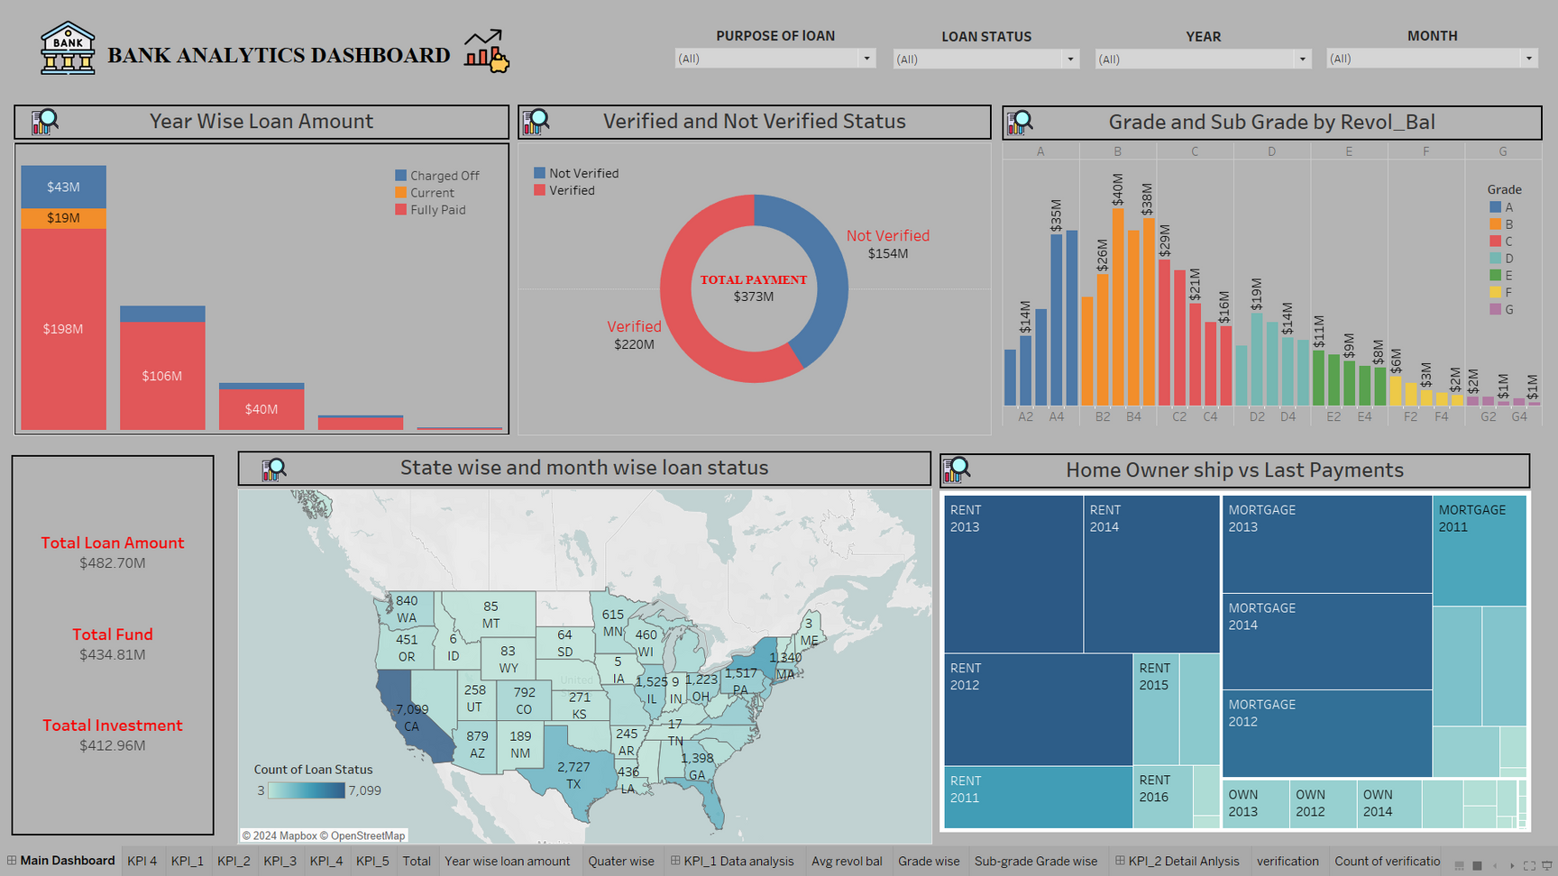
TABLEAU - DASHBOARD

Slide 12
CONCLUSION
The data reflects a robust lending environment where higher loan amounts are increasingly managed successfully, especially by borrowers with stable financial backgrounds (higher grades and verified status). It also points towards efficient credit and collection management by the institution, evidenced by high repayment rates across different demographics and states. Tailoring products to leverage these trends, focusing on verified and financially stable customers, and understanding regional variations can further enhance portfolio performance and customer satisfaction.

Slide 13

THANK YOU

